Slide 1
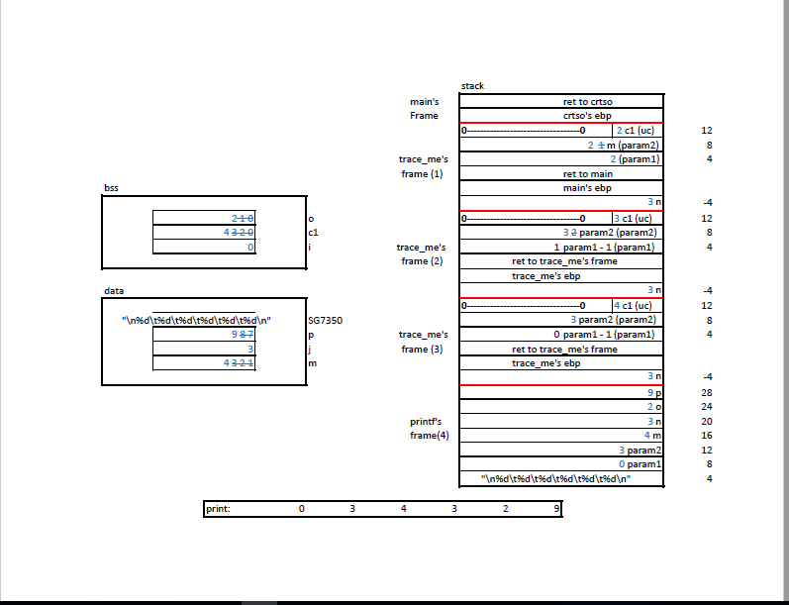
Question3 : Memory Image
MM: the string (array of char)
is stored in Data Segment
and this entry stores the
starting address of the
array

Slide 2
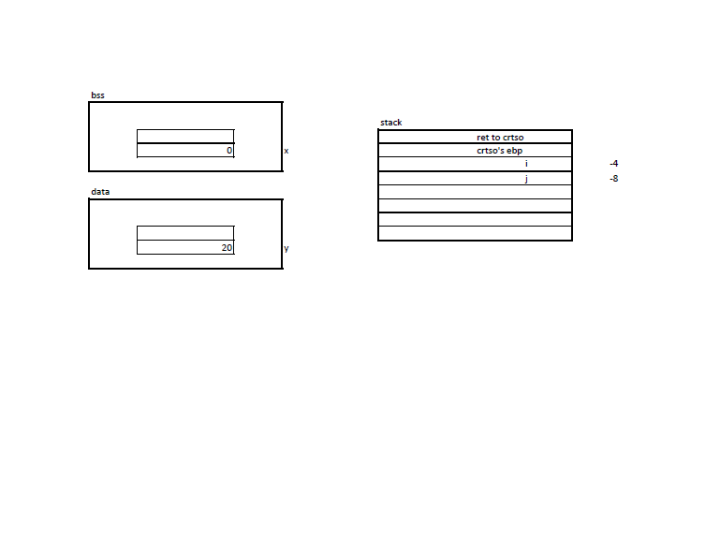
Question2: Memory Image
Even though
main( ) does not
declare them,
these three arguments
are pushed by crtso
(C Runtime Start Off
function)
envp
argc
argv
main()’s frame

